Slide 1
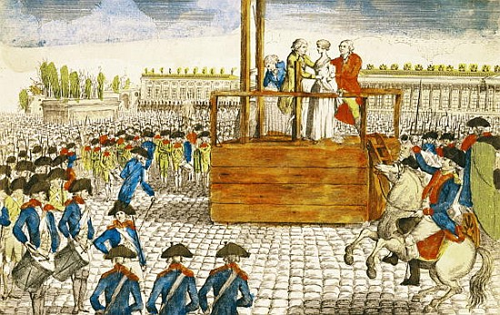
The Radical Days of The French Revolution Part 2
National Convention – new legislative body of France
National Convention gives suffrage to all male citizens, not just property owner
Abolished monarchy
Created new Constitution
King and Queen executed
SUFFRAGE – The right to vote

Slide 2
Divided Country
• Not all support changes
Robespierre (shrewd lawyer & politician) Assumes Control
Maximilien Robespierre —Jacobin leader rules France for year
known as “the Incorruptible” by followers/ tyrant by enemies
• leader of Committee for Public Safety, dictator
Rule by terror – “criminals” lose heads

Slide 3
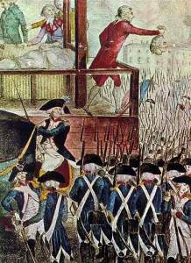
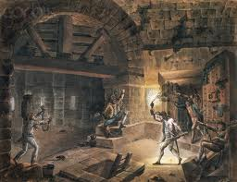
Reign of Terror —
Kills many opponents – “death to traitors!”
300,000 arrested - many falsely accused
• 17,000 executed
Thousands die in prisons
85 percent who die during Terror are middle or lower class

Slide 4
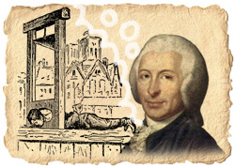
The Guillotine -
Fast Falling blade – instant death
Dr. Joseph Guillotine invented as humane way of execution – (less gruesome than undependable , messy swords or axes)
Became symbol of horror
Turn to pages 402 and 403, read “infographic” about the guillotine

Slide 5
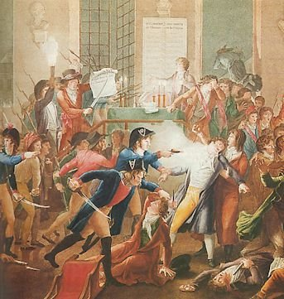
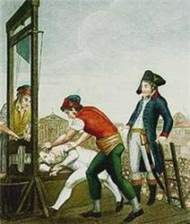
End of the Terror
July 1794, Robespierre arrested, executed
• Moderate leaders write new constitution 1795
• Five-man Directory and Two-house legislature established to restore order:
Middle class & professional people of bourgeoisie are dominant force
Weak & dictatorial
Directory held power 1795 - 1799

Slide 6
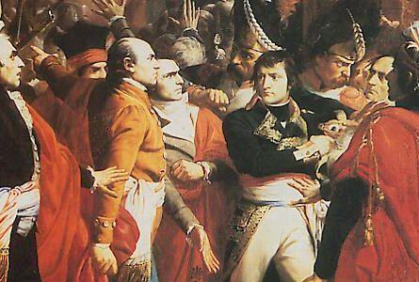
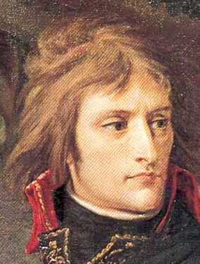
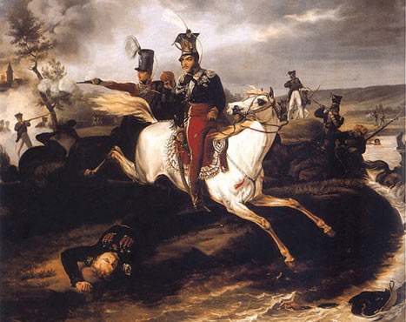
Politicians turn to Napoleon Bonaparte
• Corruption, rising prices ,discontent, chaos, rioting
New government makes Napoleon Bonaparte, (popular military hero,) commander of armies
Wanted him to follow their goals – instead – he becomes ultimate ruler of France

Slide 7
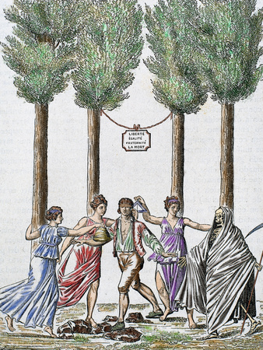
Revolution Brings Change
By 1799 : 10-year-old French Revolution dramatically changed France
Dislodged old social order
Overthrown monarchy
Church under State control
Title “Citizen” applied to people of all social classes
All titles of nobility eliminated

Slide 8
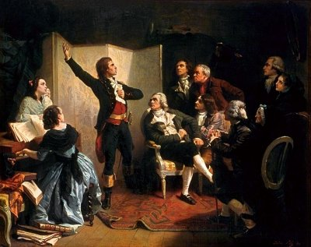
Nationalism Spreads
Nationalism = a strong feeling of pride in and devotion to one’s country
Revolution and war give French a feeling of loyalty to country, not to a king as in earlier times
many songs and festivals celebrating the nation & revolution
“La Marseilles” becomes French National Anthem
“Children of the fatherland to march against the bloody banner”

Slide 9
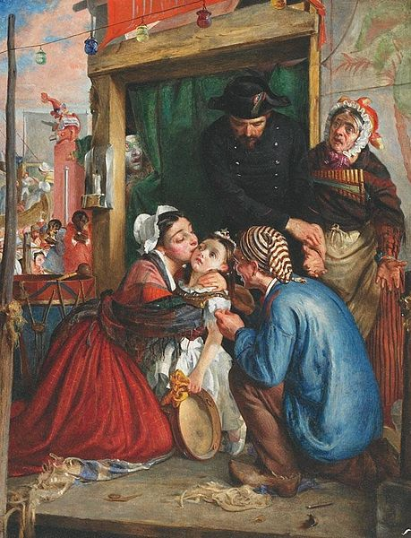
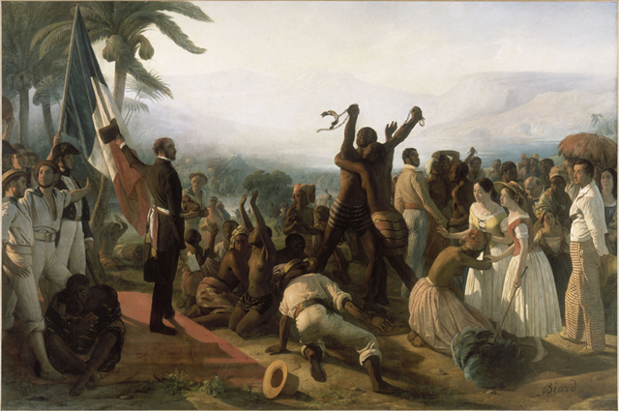
Revolutionaries Push for Social Reform
Religious toleration
Set up State schools to replace religious ones
Organized system to help the poor, old soldiers, & war widows
Abolished slavery in France’s Caribbean colonies

